Slide 1
Individual homework-computational logic
Created by Costin Carmen Stefania Cornelia

Slide 2
Theoretical result
Definition: Let U1,U2,…,Un be propositional formulas, called hypotheses and V be a formula, called conclusion . V is deducible(derivable, inferable) from U1,…,Un and we denote by U1,U2,…,Un ⊢V, if there exists a sequence (f1,f2,…,fm) of formulas such that fm=V and ∀ i ∈ {1,2,…,m} we have a) or b) or c) :
a)Fi ∈ Ap ( axiom);
b)Fi ∈ {U1,U2,…,Un} ( hypothesis );
c)Fi1,Fi2⊢mpFi, i1<i and i2<i;
The sequence (f1,f2,…,fm) is called the deduction of V from U1,U2,…,Un.

Slide 3
p->r,pvr->q, r |-q
We build the sequence of formulas(F1,F2,F3,F4,F5) as follows :
F1:p->r
F2:pvr->q
F3:r
F3|---addition pvr (F4)
F2,F4 |---mp q (F5)
Conclusion:
The sequence (F1,F2,F3,F4,F5) is the proof(deduction) of q from the hypotheses: p ->r, p v r ->q, r

Slide 4
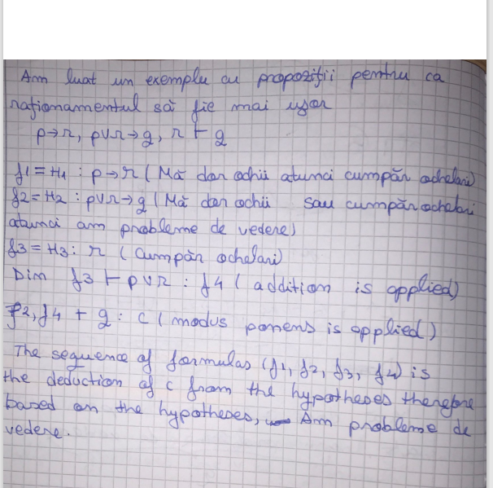
From where I started my presentation

